Slide 1

Analysis
Sri Krishna
Hemanth
Rahul
Vishal

Slide 2
Problem Statement
Customer Retention Strategy’s.
Suggest a Machine Learning model that helps in the prediction
of Customer Churn Rate.

Slide 3
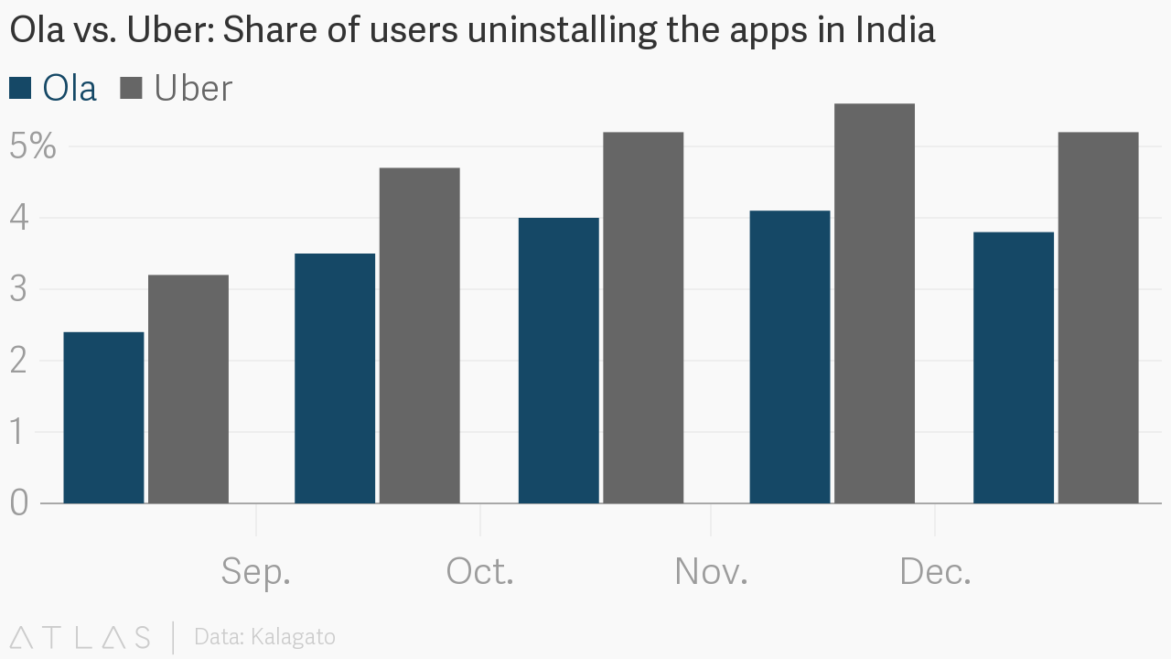
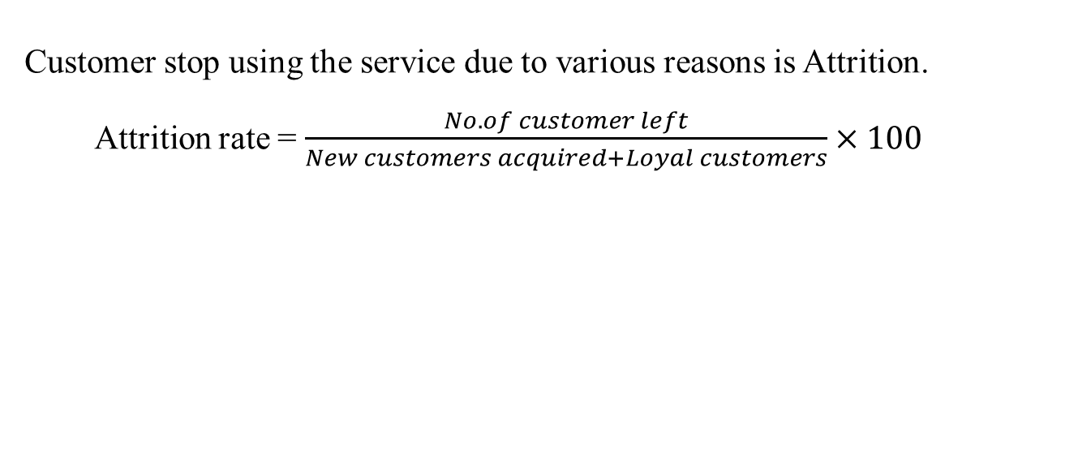
What is Attrition ?
Customer stop using the service due to various reasons is Attrition.
Attrition rate = $\frac{No.of customer left}{New customers acquired+Loyal customers}×100$

Slide 4
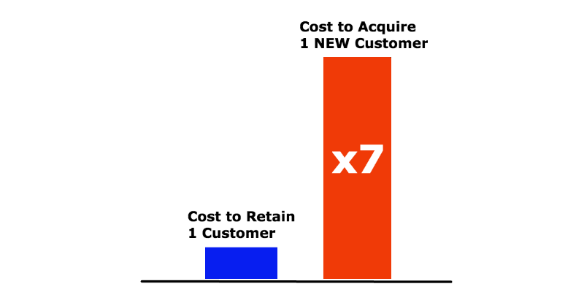
Why calculating attrition so important ?
Helps in determining the total business lost.
Helps in finding the flaws in the business model.
Customer acquiring is expensive than retaining them.

Slide 5
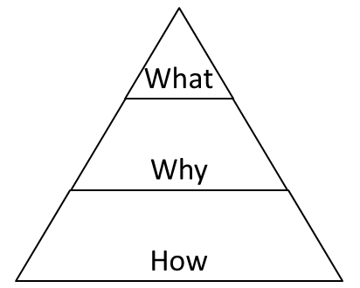
Approach
Mutually Exclusive and Collectively Exhaustive Approach (MECE)
Helps in segregating issues into logical categories
Key elements in Uber is segregated into 4 categories which are customer, driver, vehicle and miscellaneous.
Each category has different issues.
To ensure that each issue is relevant, 3 questions were posed viz. What, Why and How.
Ghost pack of each category shows the problems that are faced by that particular category

Slide 6
Problem
Vehicle/ Cabs
Miscellaneous
Driver
Customer
Price Issue
Rude Behaviour
Filling fuel during ride
Rash Driving
Drunk Customers
Delay time by Customer
Poor vehicle condition/dirty interior
Different vehicle/ license plate
App interference
Customer Care (Availability)
App Malfunction
Competitor

Slide 7
Driver- Ghost Pack
For Uber, retaining drivers is more problematic than retaining the customers.
The decline in the growth of daily rides is largely due to a reduction in driver incentives, higher fares and subsequent drop in rider demand.
Problems | Recommendations
Rider arriving late at the start location | Ride to get cancelled if the rider could not reach the start location within three minutes the driver arrives.

Slide 8
Customer- Ghost Pack
Problems | Recommendations
Unprofessional Behaviour | Counselling the drivers before including into Uber
Filling fuel during ride | Driver has to ensure that fuel is sufficient for that ride before starting the ride.
Rash Driving | Reducing the incentives for reckless drivers
Abusive behaviour or harassment | Severe actions on these drivers
Driver cancelling the ride | If frequency of cancellation exceeds threshold then reduce the incentives of driver

Slide 9
Vehicle- Ghost Pack
Problems | Recommendations
Poor vehicle condition/dirty interior | Train on proper upkeep and tidiness
Different vehicle/ license plate | Take severe actions on respective drivers

Slide 10
Miscellaneous- Ghost Pack
Problems | Recommendations
App Interface | Make app easy to navigate and use
App malfunction | Proper QA testing and fix bugs
Customer care (availability) | Provide call center for immediate support

Slide 11
COMPETITOR
Analysis

Slide 12
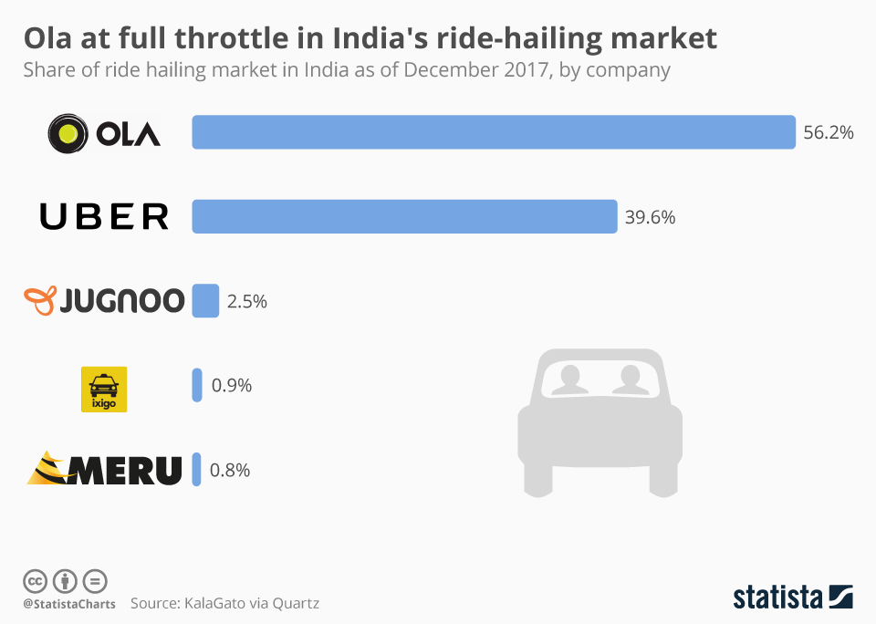

Slide 13
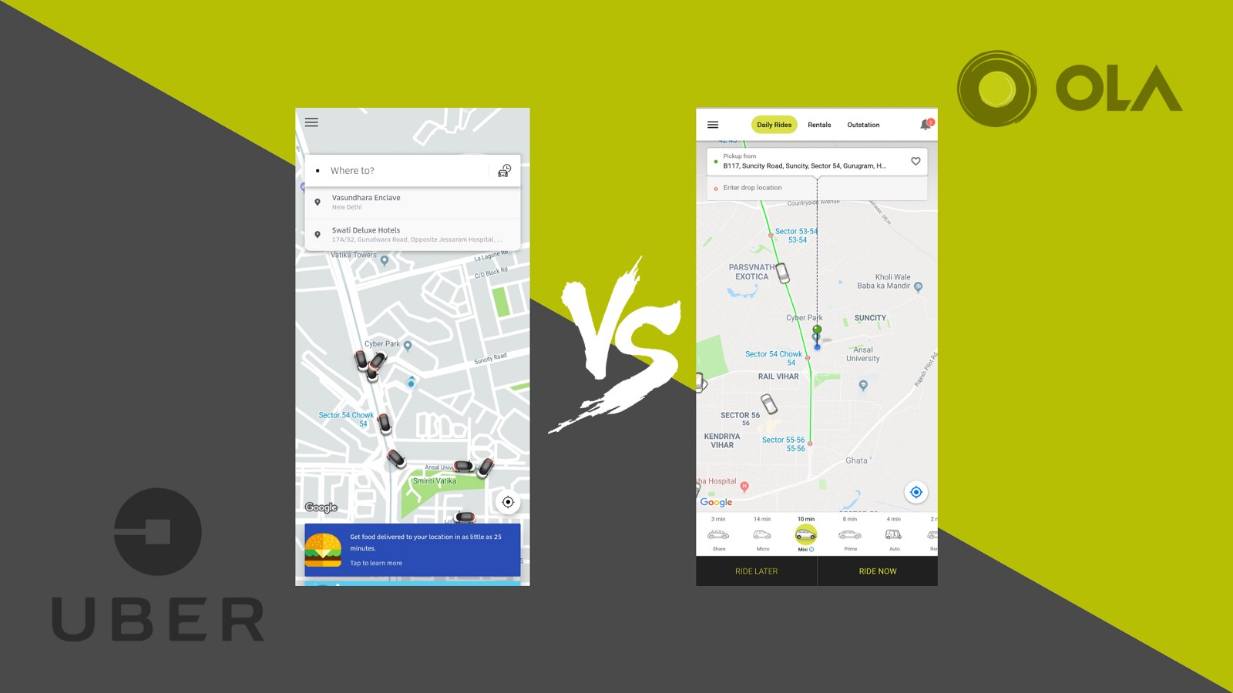

Rides
Services
Usage
App

Slide 14
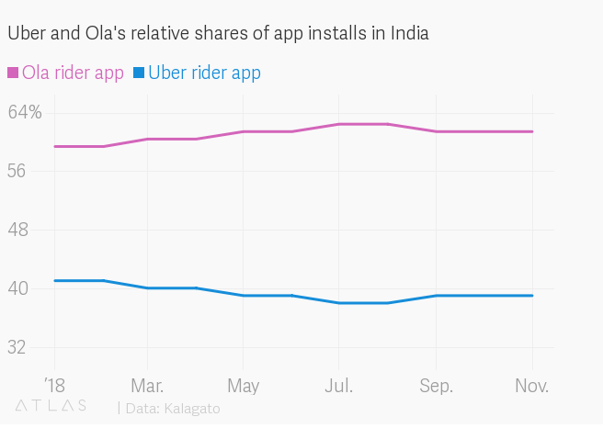
Rides
Services
Usage
App

Slide 15
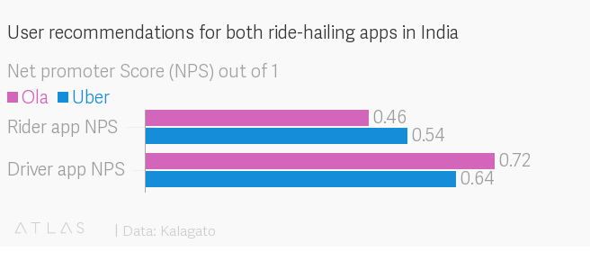
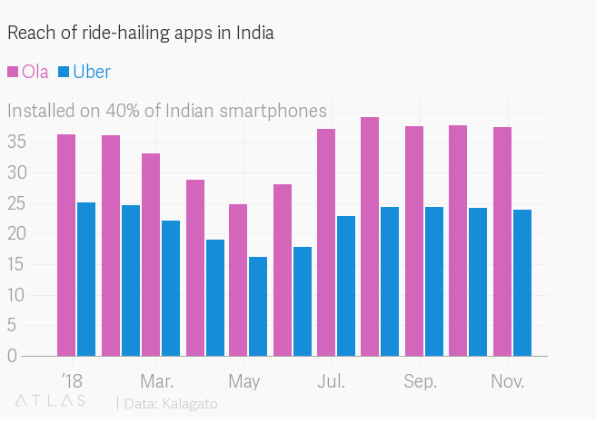
Rides
Services
Usage
App

Slide 16
Service
Rides
Usage
App

Slide 17
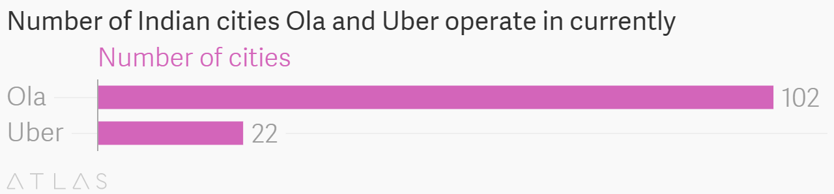
Uber | Ola
City Taxi | City Taxi
Rentals | Rentals
Pre-Bookings | Pre-Bookings
 | Outstation
 | Round Trip
Rides
Service
Usage
App

Slide 18
Recommendations

Slide 19

1.Customer Care Support :

Slide 20
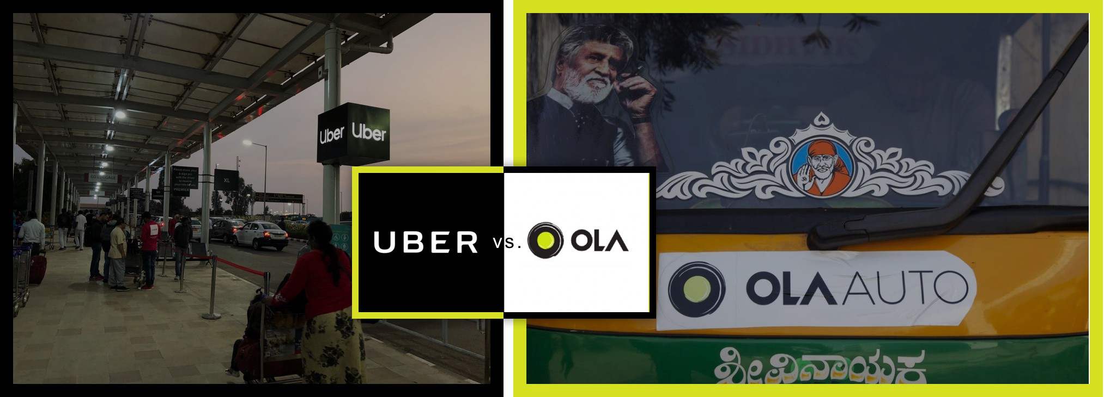
2. Advertisement :

Slide 21
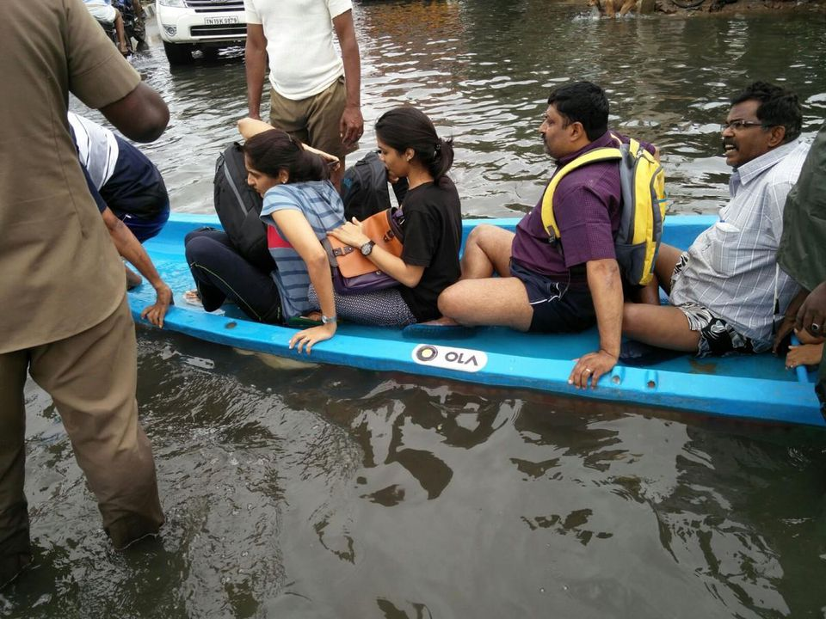
2. Advertisement :

Slide 22
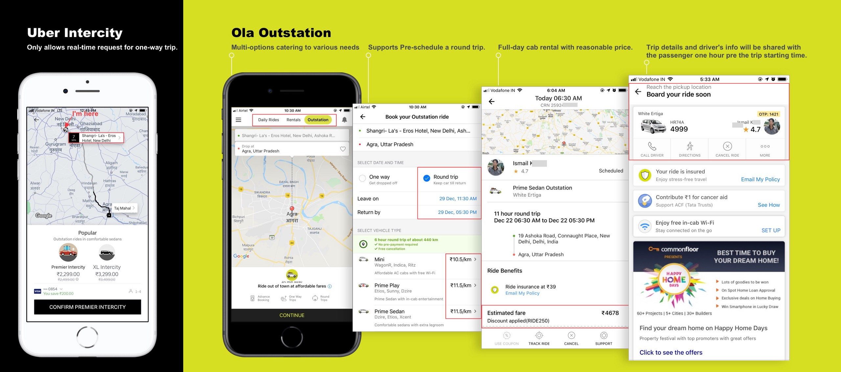
3. App Interface & Services :

Slide 23
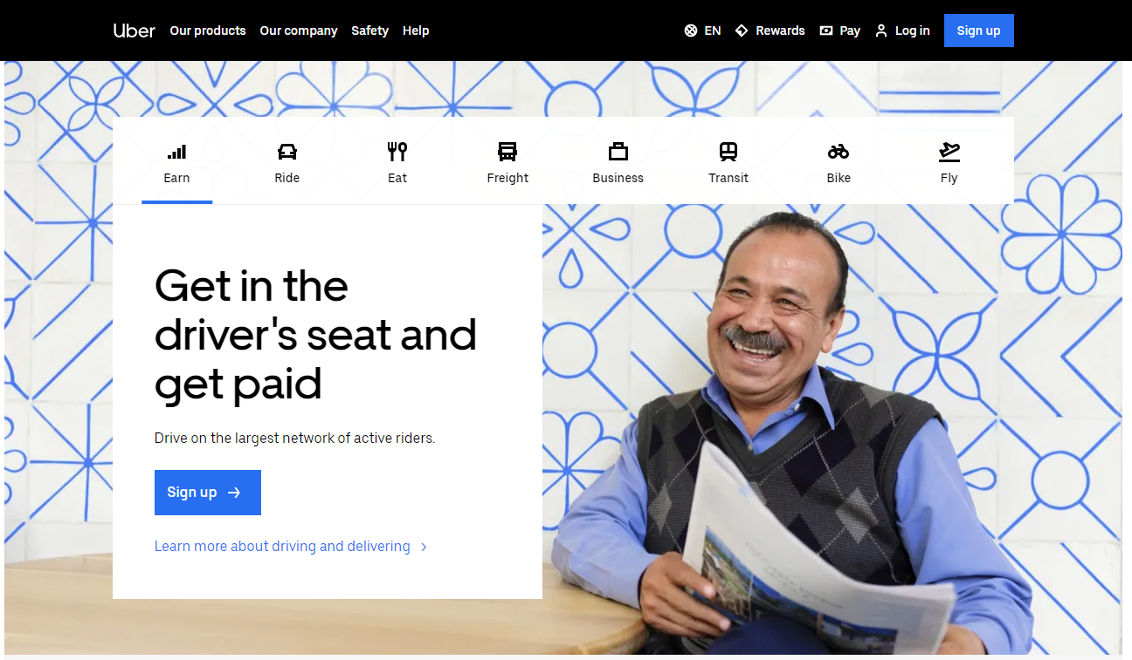
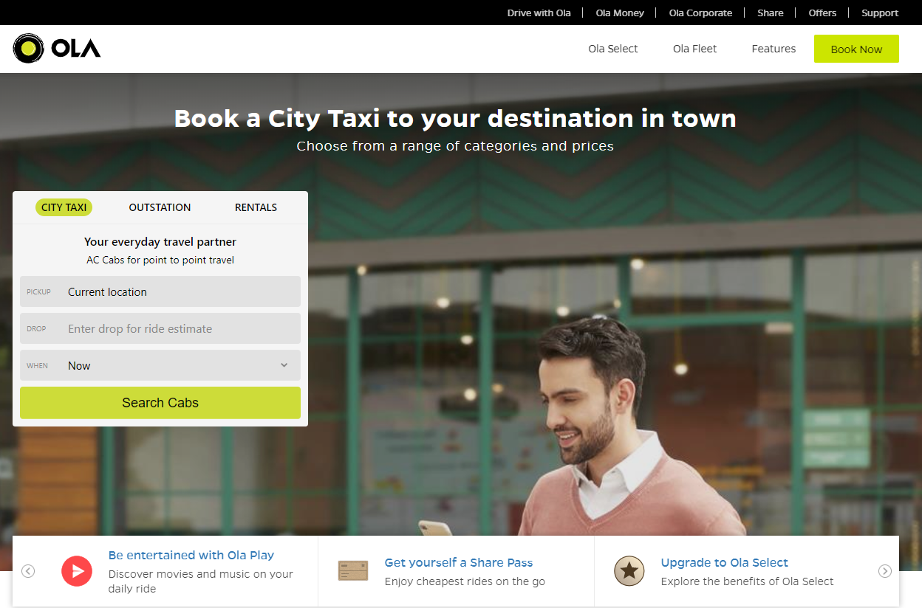
4.Web Interface :

Slide 24
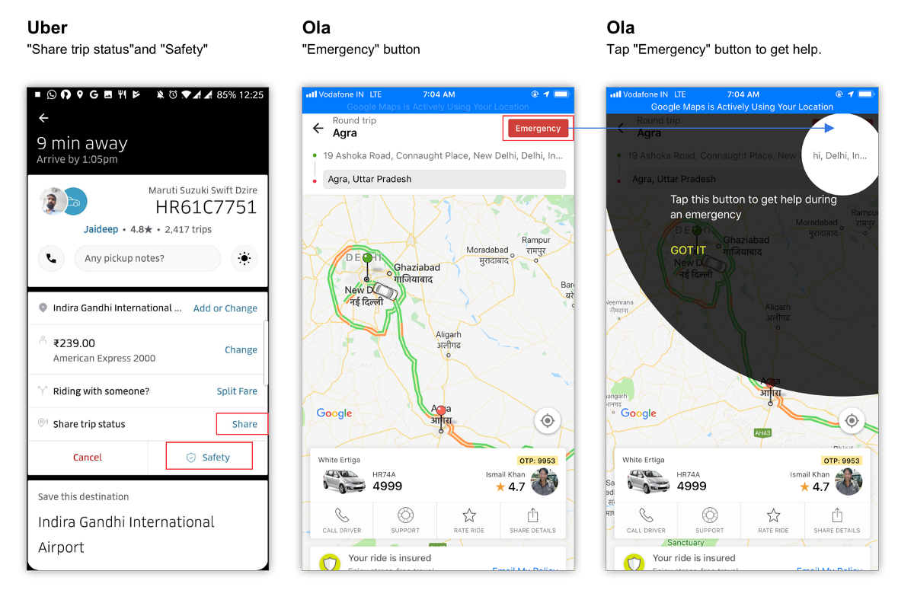
5.Safety of Passenger :

Slide 25
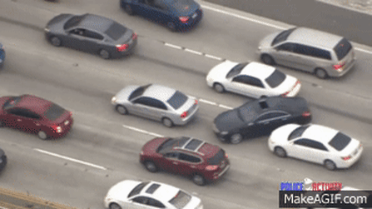
6.Taking Severe Actions on Rash Drivers :

Slide 26
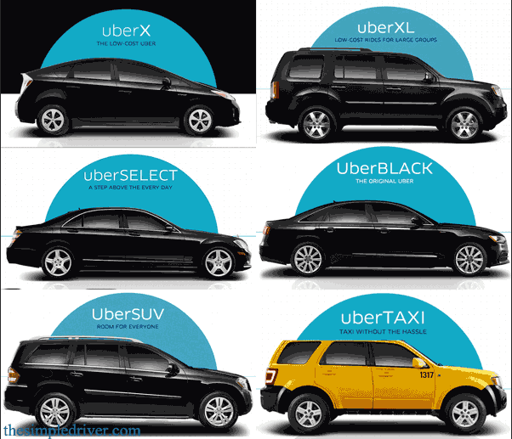
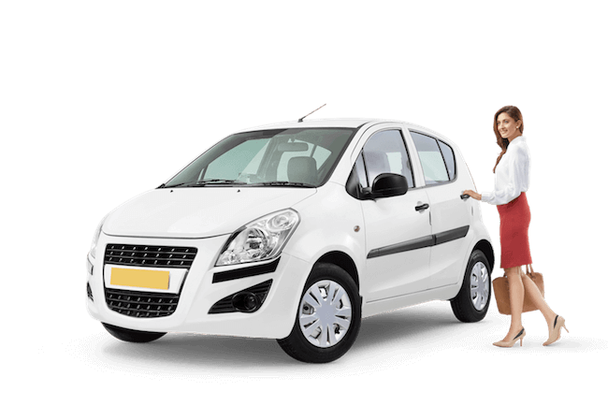
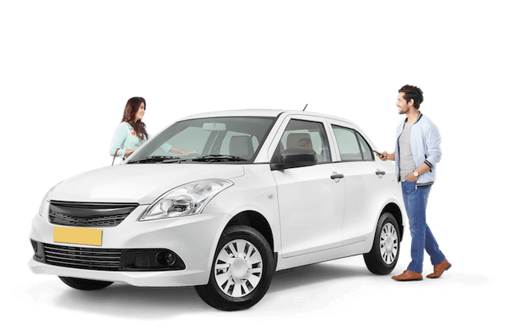
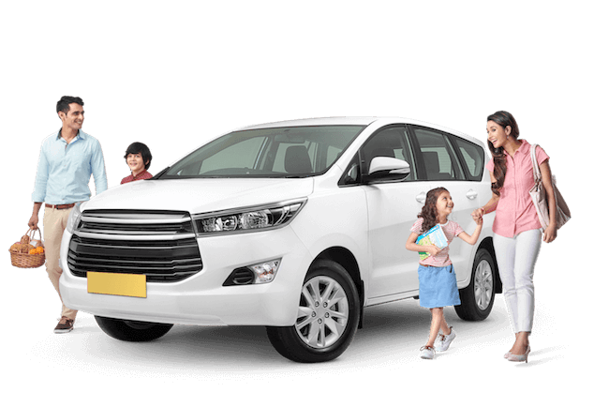

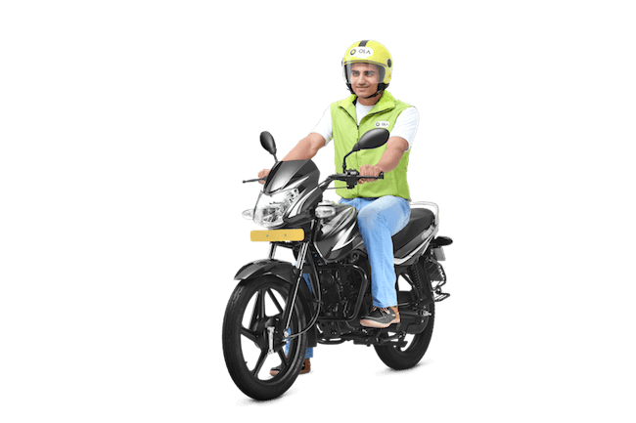
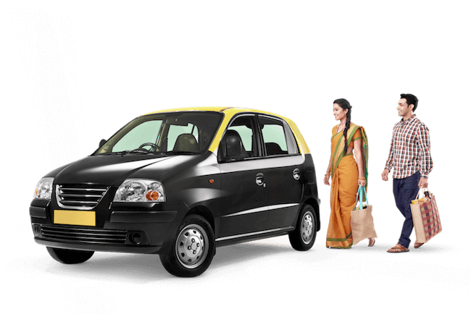
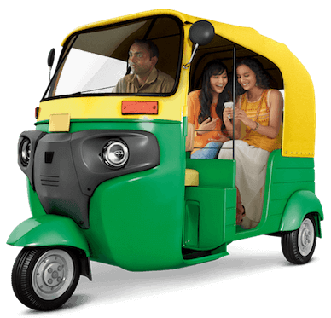
7.Services & Advertisement :
Uber | Ola
Pool | Share
UberGo | Mini
Premier | Prime Sedan
Commute | Prime Play
Moto | Bike
UberAuto | Auto
UberXL | Lux
 | Micro
 | E-rick
 | Kaali Peeli
Uber | Ola
City taxi | City taxi
Outstation
Rentals | Rentals

Slide 27

Severe actions on the drivers with abusive behaviour.
Offer incentives for providing feedback.
Take the social media complaints seriously and reply and solve them ASAP.
Expansion of business. OLA offers its services in 102 cities while Uber offers in just 22 cities.
Signing the Contract with corporate offices which offers discounts to employees.
Implementing Pass Schemes.

Slide 28
Model Selection

Slide 29
Model to predict the attrition
Customers can be segregated into 2 categories .
It’s a Classification ML problem: Logistic, KNN, DT, RF, Navies Bayes.
Columns can be frequency of rides, money spent etc.
By using Ensemble Techniques, accuracy of the predictions can be improved

Slide 30
ML model to predict attrition
Collect data
Build Classification Algorithms
Try ensemble methods
Input present customer data
Get count of customers who probably will leave Uber
Apply Time series algorithm to get attrition for particular time period

Slide 31
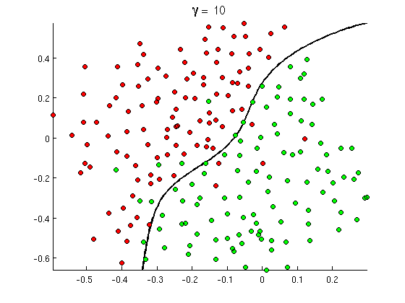
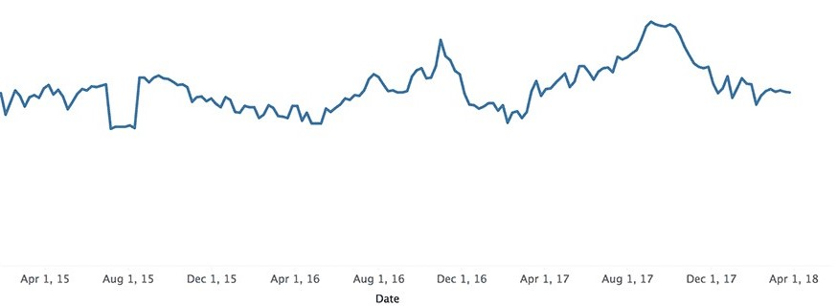
By the Time Series Analysis, attrition can be predicted for any duration

Slide 32
Referrences :
hindustan times, times of india, india today, fobes
https://www.forbes.com/sites/krnkashyap/2016/09/21/its-uber-vs-ola-for-the-battle-of-supremacy-in-the-indian-market/#1a0b736dd99f
the atlas, quartz, olacabs.com, uber india.com
medium
https://uxdesign.cc/uber-v-s-ola-cabs-in-india-6-things-you-dont-know-about-ridesharing-apps-localization-1ad806203662
data.com
crunchbase
https://news.crunchbase.com/news/inside-the-uber-s-1-revenue-growth-and-losses/
CNBC
https://www.cnbc.com/2019/04/11/uber-releases-s-1-filing-for-ipo.html
Firstpost
https://www.firstpost.com/india/drunk-ola-drivers-gangrape-kill-minor-in-kolkata-accused-arrested-body-recovered-2984604.html
Marketing91
https://www.marketing91.com/uber-competitors/
sec.gov
https://www.sec.gov/Archives/edgar/data/1543151/000119312519103850/d647752ds1.htm
medium ux collection
https://uxdesign.cc/uber-v-s-ola-cabs-in-india-6-things-you-dont-know-about-ridesharing-apps-localization-1ad806203662

Slide 33
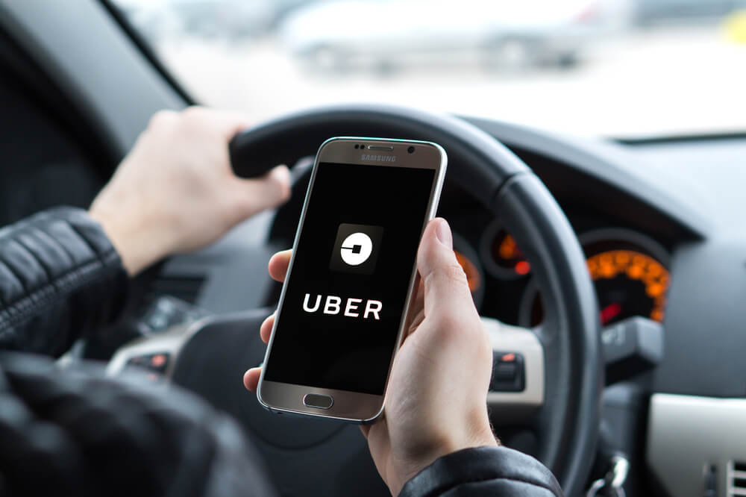
Thank you

